Slide 1

Opportunities and challenges of applying machine learning in social economics studies at the Treasury
Sijin Zhang
12 Nov 2025

Slide 2
Treasury’s roles ?
Lead economic and financial adviser to the Government and steward of the public sector financial management system
Manage state sector and public finances
Manage investment and asset performance
Provide commercial policy advice and execute commercial transactions
Manage government borrowing requirements and associated financial market activities
Provide financial guarantees and trade credit insurance to promote and support New Zealand exports, and
Central agency role – alongside Department of the Prime Minister and Cabinet (DPMC), the Public Service Commission (PSC), the Ministry for Regulation (MfR), and the Social Investment Agency (SIA) – providing State sector leadership.

Slide 3

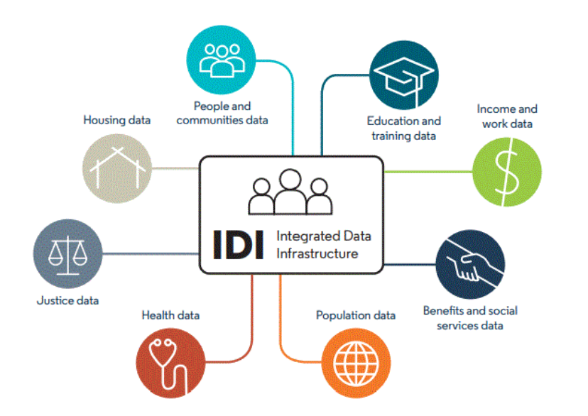
How IDI is used within Treasury
Supporting the Treasury’s tax transfer microsimulation model
Evaluating cross-domain impacts to inform policy design
Identifying at-risk populations and enabling early interventions
Contributing to international research and benchmarking

Slide 4
Opportunities of using AI
GenAI:
Productivity enhancement;
Automatic analytics and insights
……
Deep learning/machine learning:
Improve forecasting practice
Behaviour modelling
Impact and intervention analysis
Complex social economics relationships modelling
….

Slide 5
Challenges
Data sparsity and inconsistency:
Socio-economic data are often unevenly distributed across time, regions, and population cohorts.
Randomness in data collection makes direct comparison difficult.
Data quality and validation:
Ensuring quality control is challenging due to the absence of a clear “ground truth.”
Benchmark datasets or consistent reference standards are often unavailable.
Analytical focus:
In many cases, attention should be given to identifying and understanding outliers, rather than relying solely on average trends. This contrasts with many traditional AI applications, which often down-weight or remove outliers.
Cost–benefit considerations:
The added value of advanced AI or machine-learning techniques in this domain is not always clear.
Simpler, interpretable methods may yield similar insights at lower cost.
Stakeholder engagement and trust:
Explainability, transparency, and reproducibility remain major concerns for policy-relevant use.
Effective communication of model limitations is essential for stakeholder confidence and decision-making.

Slide 6
Thank you
Contact: Sijin.Zhang@Treasury.govt.nz

